Slide 1
CS 370 Introduction to Security
Course Intro

Slide 2
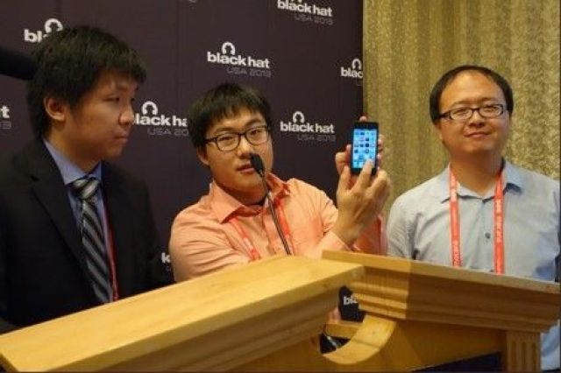
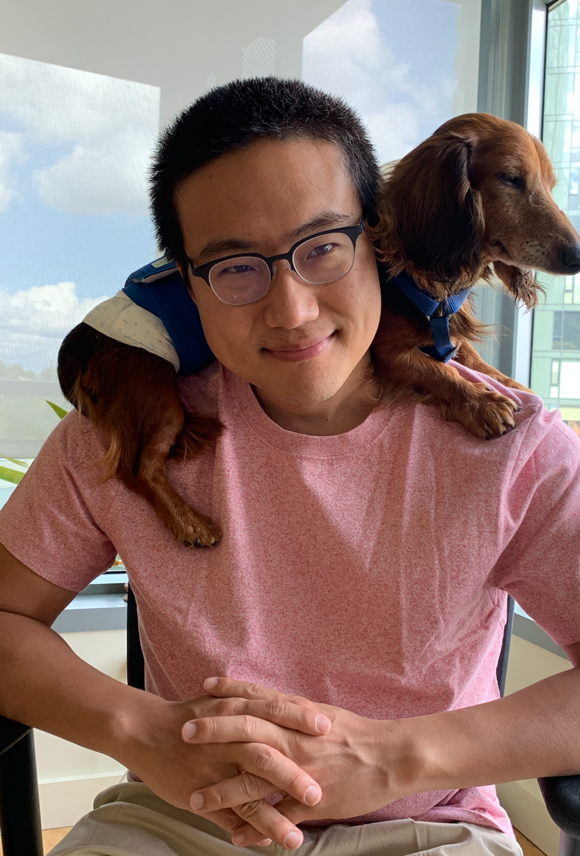
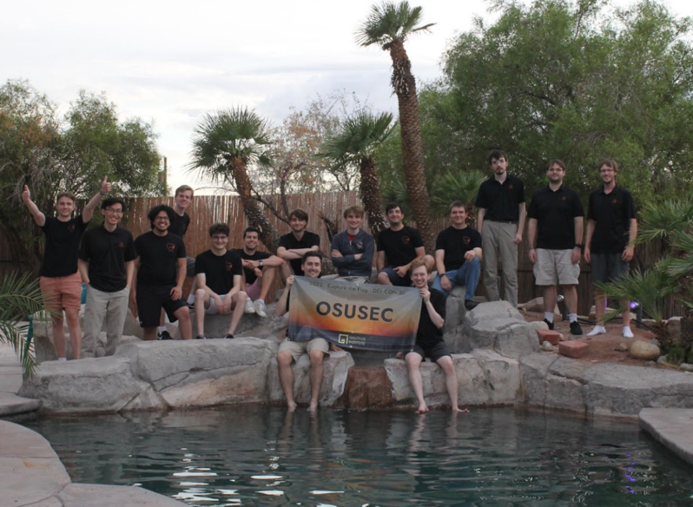
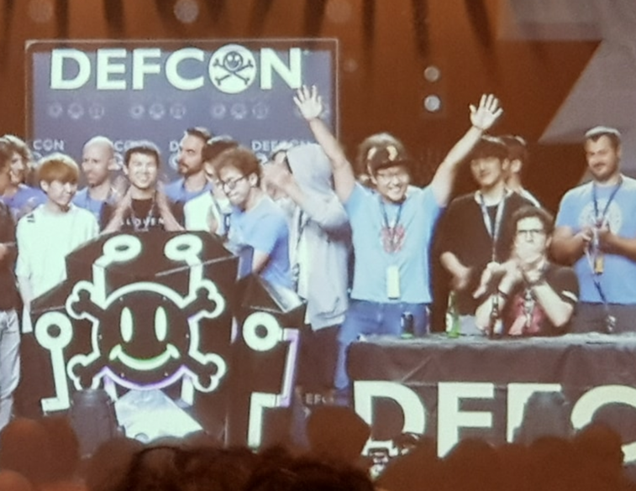
Instructor: Yeongjin Jang
At OSU Since Oct 2017
Main research area: systems security
Hacking
CPU side-channel attacks, Jailbreaking, exploit development, automatic hacking (fuzzing / symbolic execution), designing secure systems, software security, blockchain, DeFi, etc..
Faculty advisor of OSUSEC
CS444/544 Operating Systems II
CS499/579 Cyber Attacks and Defense
CS499/579 Systems Security
Feel free to reach me if you are interested in cybersecurity…
Join OSUSEC!

Slide 3

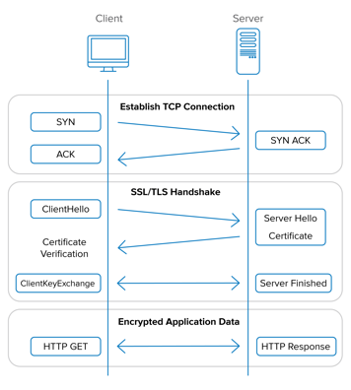
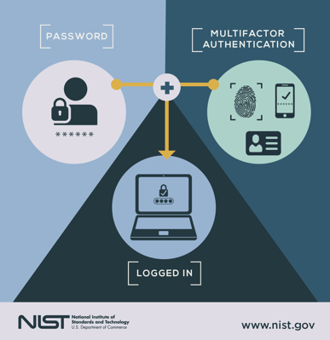
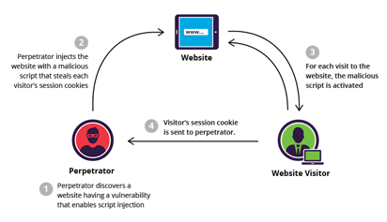
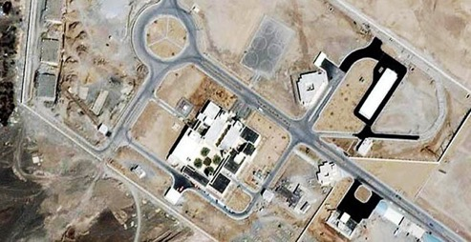
Course Description
Goal: Learn modern cybersecurity techniques
Target: Beginners
Lecture & Micro-assignments
Learn high-level fundamental concepts in the lecture
Practice engineering details with micro-assignments
There will be many assignments, but they are small and fun
Topics
Cryptography (Symmetric, Asymmetric, HMAC)
Network Security (SSL/TLS and PKI)
Authentication (Password/Private Key/Biometrics/Multi-factor)
Web Security (SQLi, parameter injection, XSS, CSRF, etc.)
Software Security (Buffer overflow, logic bugs, static and dynamic analysis)
Malware, Phishing, Ransomware, Privacy, and others..

Slide 4
Course Objective
Learn modern security technologies
Be able to answer the following questions:
How and why can cryptography make our communication secure?
How can we ensure the other end at online is the right entity (person/server)?
Why should we use two- or multi-factor authentication? What makes attackers difficult for doing what?
What are the effect of incorrectly deployed systems (Web/Software)?
How does hacking work? What can attackers do?
What is malware, and why are they dangerous?
How can the Stuxnet malware break Iranian Nuclear Facility remotely?
Why can’t we decrypt ransomware encrypted files?
Why can we decrypt for some other ransomware?

Slide 5
Important Links
Website: https://cs370.unexploitable.systems/
Instructor: Dr. Yeongjin Jang (yeongjin.jang@oregonstate.edu)
TAs:
Jeevan John
Scoring Server: https://ctf.unexploitable.systems
Discord Server: https://discord.gg/KbnnWNCr2k
Assignment server: vm-ctf1.eecs.oregonstate.edu
Please connect this via flip
Instructions: https://cs370.unexploitable.systems/rules.html

Slide 6
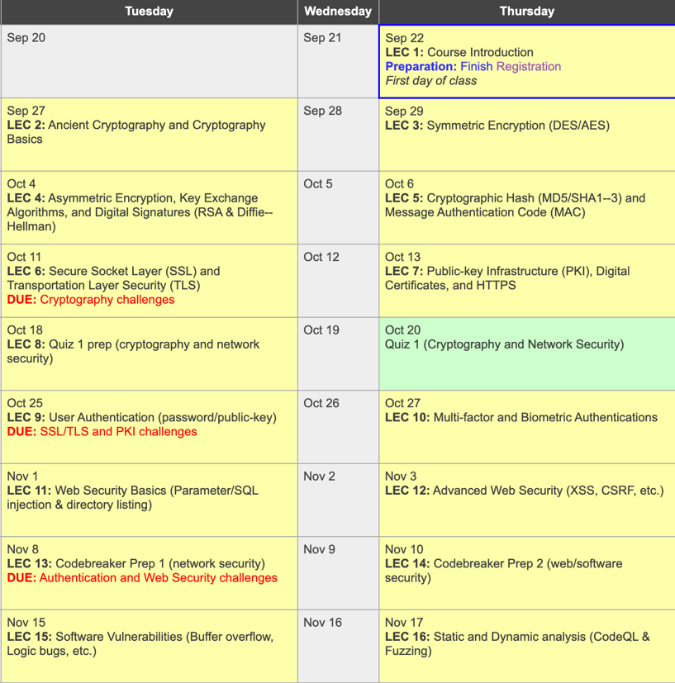
Course Structure
10 weeks schedule
https://cs370.unexploitable.systems/cal.html
Cryptography (2 weeks)
Network Security (2 weeks)
Authentication (1 week)
Web security (1 week)
Software security (1 week)
Malware and others (1 week)
NSA Codebreaker (1 week)
Quizzes (1 week)
In-person (Zoom sync) lectures (videos will be available on YouTube)
TA/myself address questions on Discord

Slide 7
Meeting Time (with me)
Lecture (in-person, video, synchronous)
Tu/Th 2:00pm
Video link will be available on Canvas/Homepage after 6 pm
Synchronous Zoom link:
https://oregonstate.zoom.us/j/97364167540?pwd=S3B6dFowSjZGNU44M1g4aFQrc2kyQT09
My office hour (@ KEC 3079)
Wed 05:30pm – 07:00pm

Slide 8
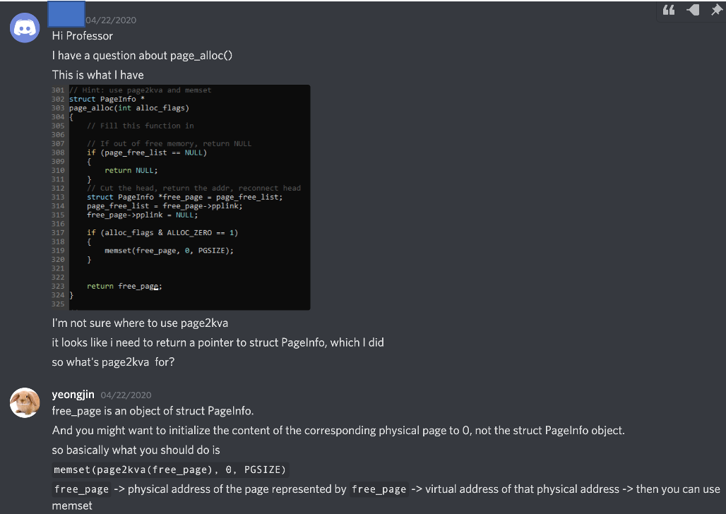
TA Office Hours
Availability will be posted later…
Ask any questions
Please help each other
Discord Server
https://discord.gg/KbnnWNCr2k

Slide 9
Grading (Can be changed)
60% micro assignments
15% each per assignment set
20% Quizzes (mini-exam)
Quiz 1 (10/20) : Cryptography and Network Security
Quiz 2 (11/22): Authentication and Web/Software Security
All quizzes will be on CANVAS (remote)
Fully open material (do not search on the Internet)
You will have up to 3 trials (I will take your best score)
~60 minutes at most, but I will set the time as 120min

Slide 10
Micro-Assignments (60%)
Four sets
Set 1: Cryptography challenges
Practice how to encrypt data
Practice how to break crypto schemes
Play with digital signatures
Practice what can go wrong if there is no message authentication
Set 2: SSL/TLS and PKI
Practice how SSL/TLS works
Practice how certificates are utilized in authentication
Know how to construct secure communication channel
Know how to attack such constructions…

Slide 11
Micro-Assignments (60%)
Four sets
Set 3: Authentication and Web Security
Practice the use of password/private-key authentication
Attack web server via SQL injection and parameter injection
Attack web service users via Cross-site Scripting/Request Forgery, etc.
Set 4: Software Security
Know how to find and attack buffer overflow vulnerability
Know how to find and attack logic bugs
Apply static (CodeQL) and dynamic (fuzzing) analysis to programs for finding vulnerabilities…

Slide 12

Micro-Assignments (60%)
Four sets
Set 3: Authentication and Web Security
Practice the use of password/private-key authentication
Attack web server via SQL injection and parameter injection
Attack web service users via Cross-site Scripting/Request Forgery, etc.
Set 4: Software Security
Know how to find and attack buffer overflow vulnerability
Know how to find and attack logic bugs
Apply static (CodeQL) and dynamic (fuzzing) analysis to programs for finding vulnerabilities…

Slide 13
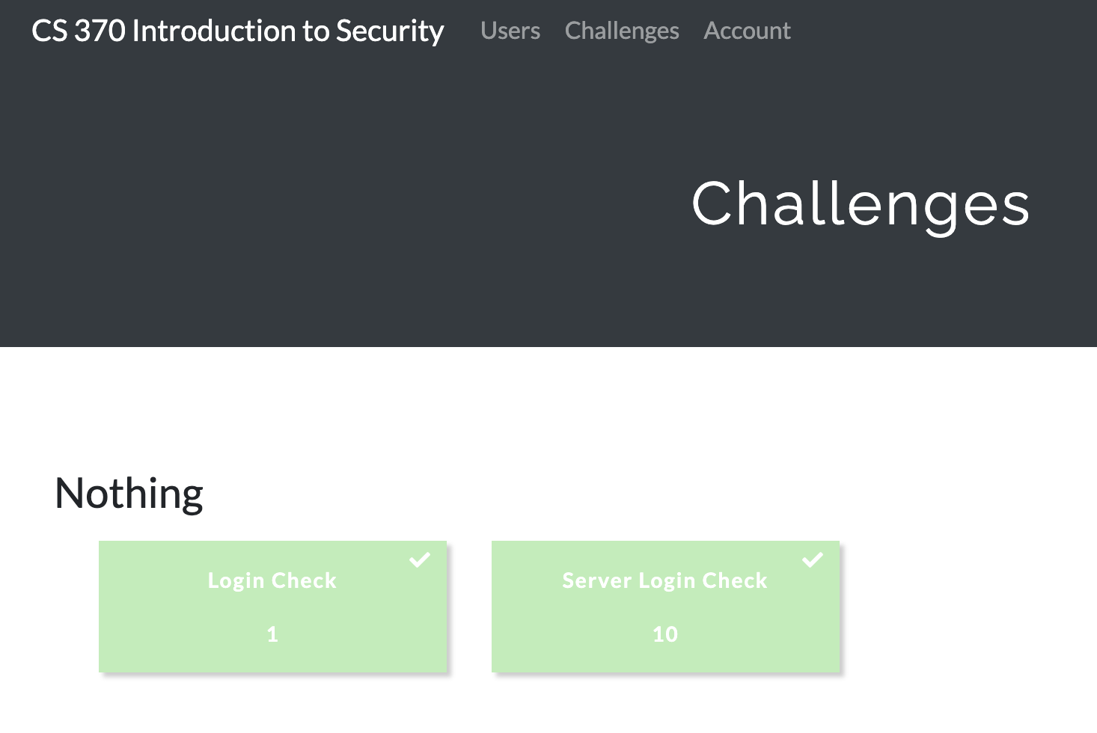
How to Conduct Assignments?
Scoring System

Slide 14
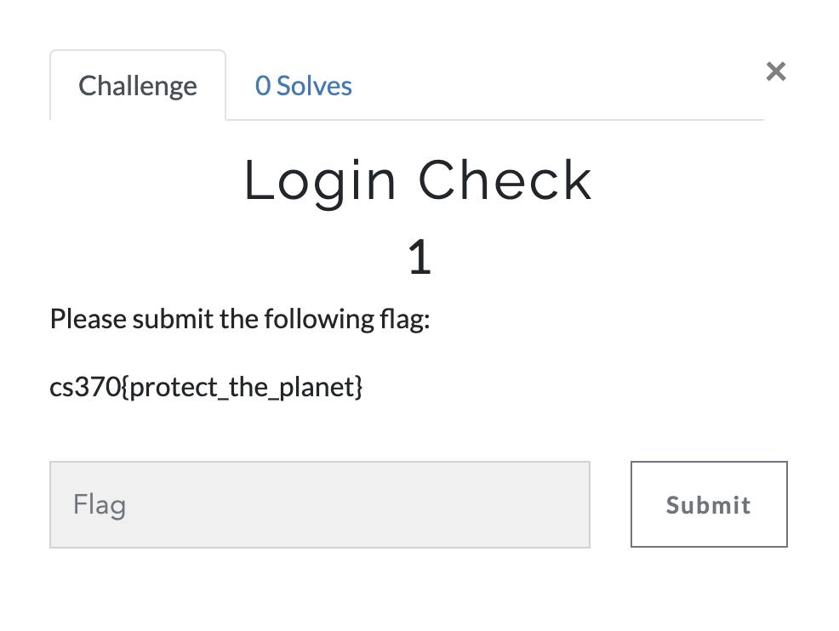
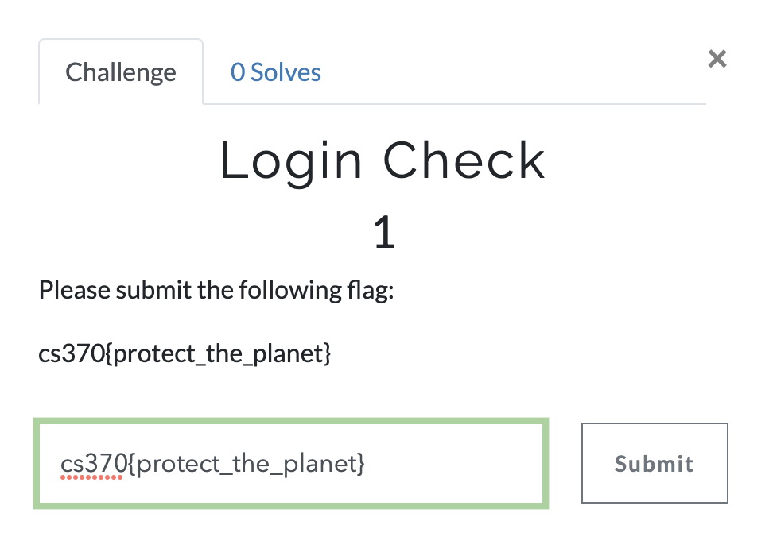
How to Conduct Assignments?
Scoring System

Slide 15
Assignment Rules
DO NOT SHARE YOUR CODE WITH OTHER STUDENTS
You are encouraged to discuss with others about the assignments but do not ask/give the code to the others
Do not copy other students’ code or code available in online
Do not publish your code online
You will be asked to submit a simple write-up for the assignment
Describe how you solve each challenges
Mention your collaborators in the write-up
Do not copy other students’ write-up
Do not publish your write-up online

Slide 16
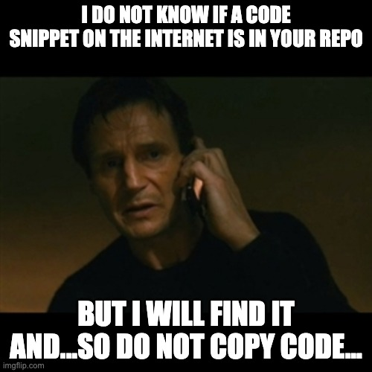
Lab Rules
Plagiarism will be punished via the Office of Student Life..
E.g., getting F or zero point for the lab assignment that matters with plagiarism…
Please refer the Code of Student Conduct
https://studentlife.oregonstate.edu/studentconduct/academicmisconduct
https://studentlife.oregonstate.edu/sites/studentlife.oregonstate.edu/files/edited_code_of_student_conduct.pdf

Slide 17
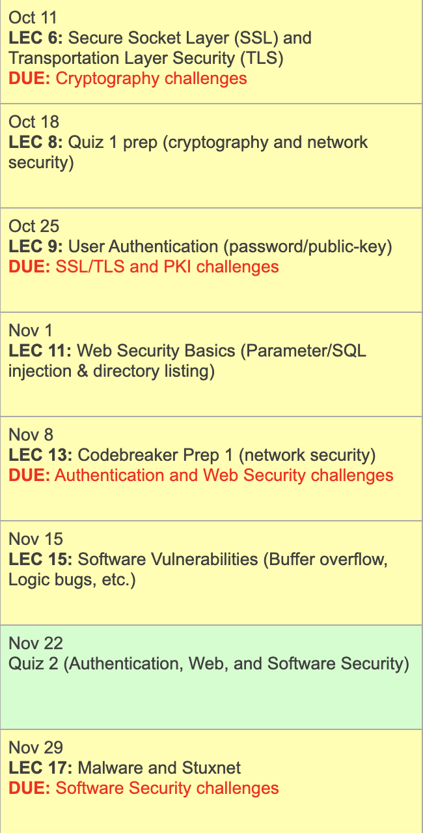
Due Dates on the Calendar
https://cs370.unexploitable.systems/cal.html
At 2:00 pm of the due date; right before the class starts!

Slide 18
Lab Rules – Late Submissions
If you submit your assignment before the due date, then
You will get 100% of credits based on the grading result
If you submit your assignment within one week after the due date, then
You will get 50% of credits based on the grading result
If you submit your assignment one week after the due date, then
You will get 0% pts…

Slide 19
Others
Be active on Discord
Help each other
Don’t share the code directly; share concepts & ideas
We learn a lot by implementing the concepts with our own hand

Slide 20
Assignment
Please follow the lab instruction
https://cs370.unexploitable.systems/rules.html
To register yourself on the scoring and the challenge server
https://ctf.unexploitable.systems/
vm-ctf1.eecs.oregonstate.edu

